Slide 1
E-COMMERCE COMPANY ANALYSIS USING SQL
Presented By: Dristi Handique
Date: 13-08-2025

Slide 2
INTRODUCTION
The project focuses on an e-commerce company facing challenges with tables i.e., customers, products, orders, order details, e-commerce company. Through a comprehensive data analysis approach using SQL, this case study aims to address key business problems and insights such as market segment analysis, high value products, sales trend, customer acquisition.

Slide 3

Data Base Structure
Customers | Products | Orders | Order Details | E-Commerce-Company
customer_id | product_id | order_id | order_id | order_id
name | name | order_date | product_id | order_date
location | category | customer_id | quantity | customer_id
 | price | total_amount | price_per_unit | total_amount

Slide 4
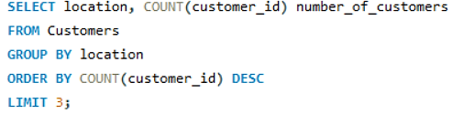
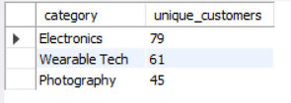
Market Segmentation Analysis:
Identify the top 3 cities with the highest number of customers.

Slide 5
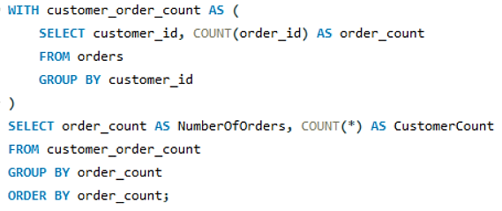
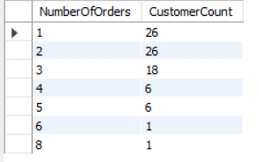
Engagement Depth Analysis:
Determine the distribution of customers by the number of orders placed.
No. of Orders: 1 → Term: One-time buyer.
No. of Orders: 2–4 → Term: Occasional Shoppers.
No. of Orders: >4 → Term: Regular customers.

Slide 6
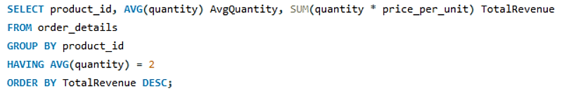

Purchase High-value Products:
Identify products where the average purchase quantity per order is 2 but with a high total revenue.

Slide 7
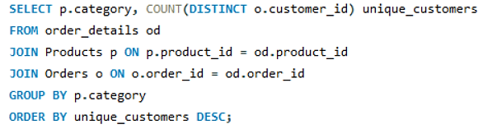
Category-wise Customer Reach:
For each product category, calculate the unique number of customers purchasing from it.

Slide 8
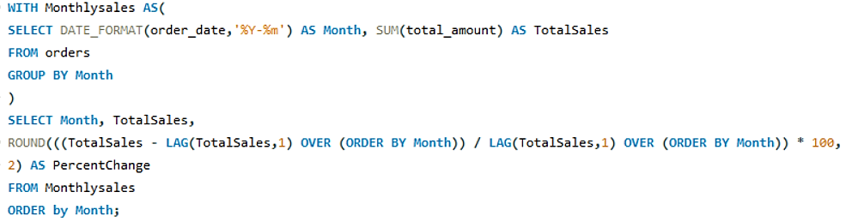
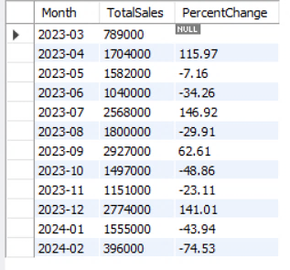
Sales Trend Analysis:
Analyze the month-on-month percentage change in total sales.

Slide 9
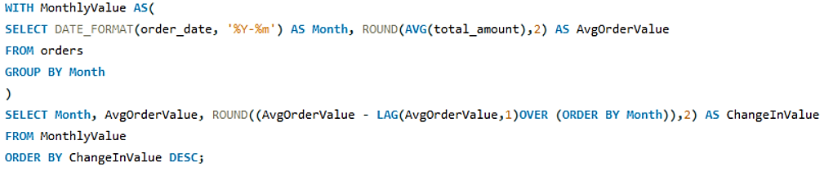
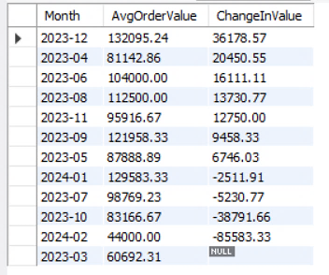
Average Order Value Fluctuation:
Examine how the average order value changes month-on-month.

Slide 10
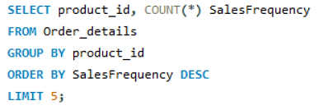
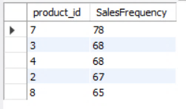
Inventory Refresh Rate:
Based on sales data, identify products with the fastest turnover rates.

Slide 11
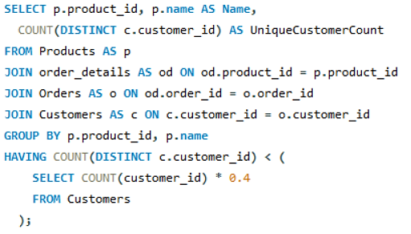

Low Engagement Products:
List products purchased by less than 40% of the customer base, indicating potential mismatches between inventory and customer interest.

Slide 12
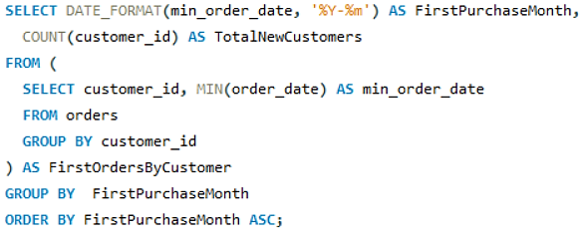
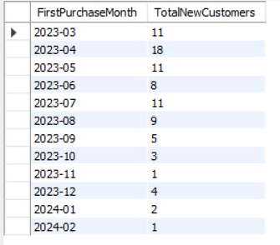
Customer Acquisition Trend:
Evaluate the month-on-month growth rate in the customer base

Slide 13
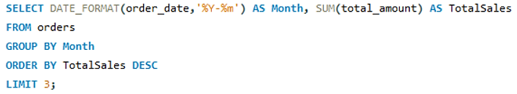
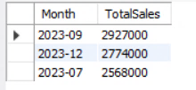
Peak Sales Period Identification:
Identify the months with the highest sales volume, aiding in planning for stock levels, marketing efforts, and staffing in anticipation of peak demand periods.

Slide 14
Thank You!

